Slide 1


David Heck
3/9/2023

Slide 2

Outline
Executive Summary
Introduction
Methodology
Results
Conclusion
Appendix

Slide 3
Executive Summary
Based on the analysis of prior SpaceX launch and landing data we are able to run predictive models to tell us which attributes of the process are important to the outcome. We utilized public SpaceX data, Python Visualization tools, and Python Machine Learning algorithms to arrive at our results. While many factors can contribute to a successful launch and landing, we found these to be optimum:
Site KSC LC-39A in Florida
Payload Mass <= 7000 kg
Booster Type FT
Low Earth Orbits

Slide 4
Introduction
Project Overview
As a research effort for prospective aerospace companies interested in developing their space programs, we would like to look at the SpaceX Falcon 9 model. By being able to land and reuse their booster rockets, the cost savings for this venture is a big draw. By analyzing historical launch and landing data from SpaceX, we hope to find which attributes of the process are more likely to lead to a successful landing, and thus cost savings for the prospective aerospace company.
Questions to be Answered
As mentioned, by analyzing prior launch/landing data we want to know what attributes of the process are likely to contribute to a successful landing. For example, are certain launch locations, payload mass or orbit type likely to lead to a successful landing? Let's find out!

Slide 5

Section 1

Slide 6
Methodology
Executive Summary
Data collection methodology:
SpaceX launch data pulled from SpaceX API via Python interface
Perform data wrangling
Cleaned data using categorical means to replace missing values
Perform exploratory data analysis (EDA) using visualization and SQL
Utilized data visualization tools and aggregate SQL functions to further analyze data
Perform interactive visual analytics using Folium and Plotly Dash
Performed geographical analytics and interactive dash graphs to investigate data
Perform predictive analysis using classification models
Ran various models to find the most accurate prediction of mission success/failure

Slide 7
Data Collection
Data was pulled from the SpaceX wiki page which consists of launch and landing data from prior missions. Additional data was pulled using the Python get command, making calls to the following SpaceX API URL's. Once downloaded the JSON objects are converted to usable Pandas data frames.
Rockets, Payloads, Launchpads, Outcome data
SpaceX API
WGET
JSON Objects
Pandas Dataframes

Slide 8
Data Collection – SpaceX API
Data was pulled via the SpaceX API engine to gather launch/outcome data. The dataset was further enchance by grabbing data on the Launch Sites, Rockets Types and Payload Types
https://github.com/dheck500/coursera-data-science-capstone/blob/master/labs-01-spacex-data-collection-api.ipynb
SpaceX API
WGET
Rocket Types
Launch Sites
Payload Types
Outcomes

Slide 9
Data Collection - Scraping
Falcon 9 SpaceX data was pulled from the SpaceX Wiki page using WGET. Data was then reformatted using BeautifulSoup where HTML items could be parsed into Dataframes.
https://github.com/dheck500/coursera-data-science-capstone/blob/master/labs-02-webscraping.ipynb
SpaceX Wiki
WGET
Beautiful Soup
DataFrame

Slide 10
Data Wrangling
Once imported we found that several attributes were blank. These were filled in by:
Average Payload Mass
Nan Values
https://github.com/dheck500/coursera-data-science-capstone/blob/master/labs-03-spacex-Data%20wrangling.ipynb
DataFrame
Adjust for Null Values
Clean DataFrame

Slide 11
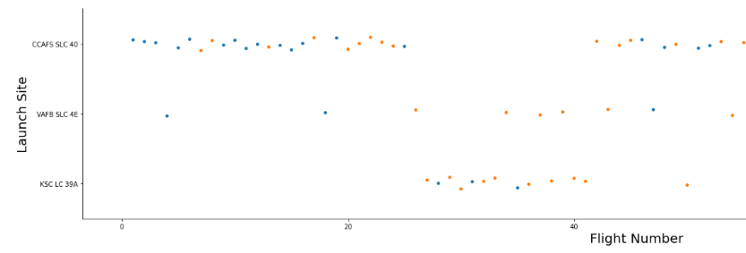
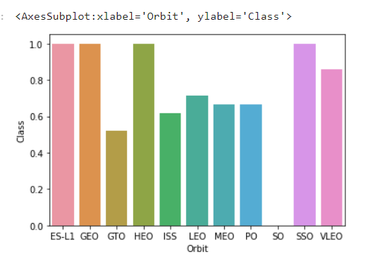
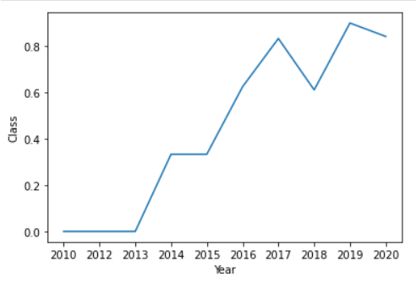
EDA with Data Visualization
To analyze the data we looked at Scatter charts for Payload Mass, Flight Number, Launch Site.
We also looked at mission success rates by Orbit Type and over time using bar and line graphs.
https://github.com/dheck500/coursera-data-science-capstone/blob/master/labs-05-eda-dataviz.ipynb

Slide 12
EDA with SQL
Further Data Analysis was performed using SQL
Unique Names of Launch Sites
Average Payload Mass by Booster
Distribution of most commonly seen Outcomes
https://github.com/dheck500/coursera-data-science-capstone/blob/master/labs-04-eda-sql-coursera.ipynb

Slide 13
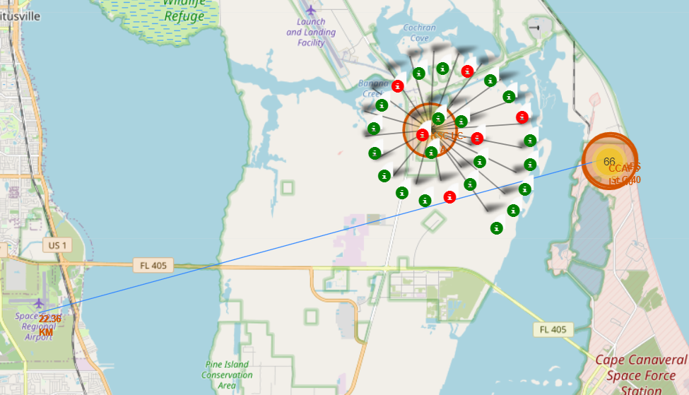
Build an Interactive Map with Folium
Markers were added for each launch site. By incorporating the color coded outcomes we are able to see which sites are more successful.
https://github.com/dheck500/coursera-data-science-capstone/blob/master/labs-06-launch-site-location.ipynb

Slide 14
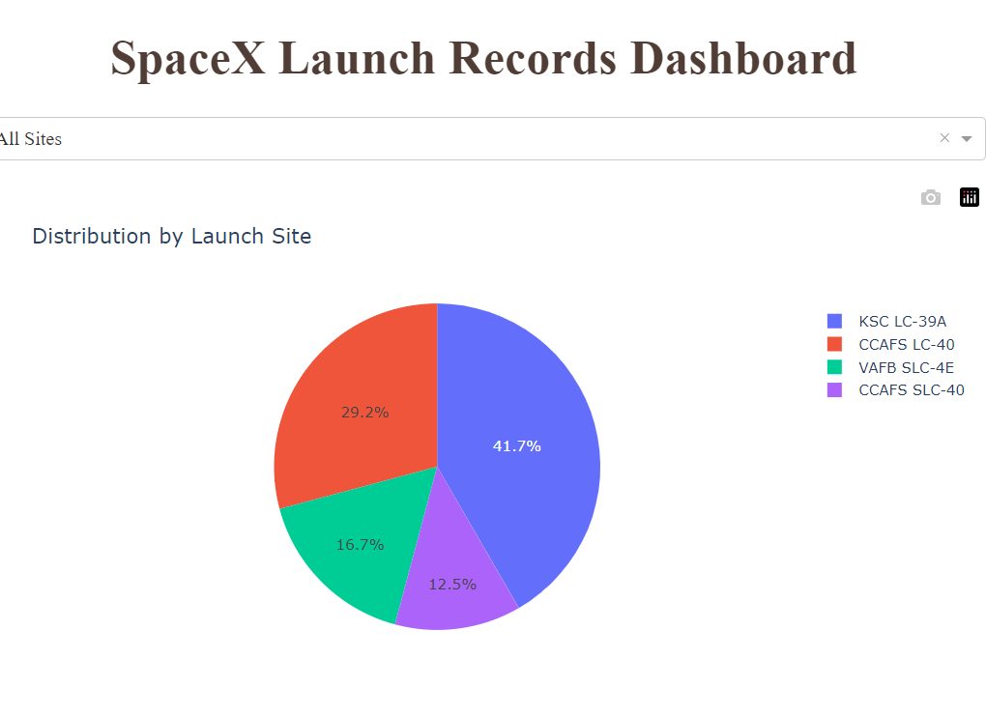
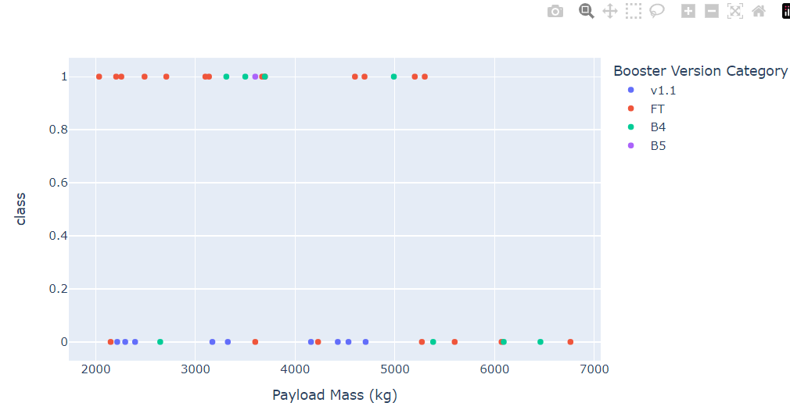
Build a Dashboard with Plotly Dash
Using Plotly Dash we have an interactive set of graphs that we can further analyze outcome data by site.
https://github.com/dheck500/coursera-data-science-capstone/blob/master/spacex_dash_app.py

Slide 15
Predictive Analysis (Classification)
Using the launch data attributes and the binary classification of outcome 0 (failure) or 1 (success), we ran predictions using these models:
Logistical Regression
SVM
Decision Tree
K-Nearest Neighbor
https://github.com/dheck500/coursera-data-science-capstone/blob/master/labs-07-SpaceX_Machine%20Learning%20Prediction_Part_5.ipynb

Slide 16
Results
Based on the analysis we found that results are more favorable for success when:
Site KSC LC-39A in Florida
Payload Mass <= 7000 kg
Booster Type FT
Low Earth Orbits
For the models we analyzed we found the Decision Tree model returned the best accuracy for predicting outcomes.

Slide 17

Section 2

Slide 18
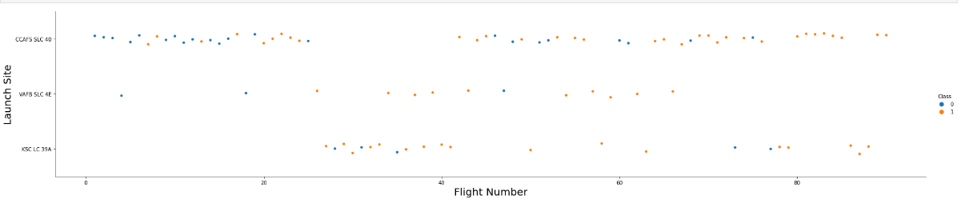
Flight Number vs. Launch Site
Show a scatter plot of Flight Number vs. Launch Site
Show the screenshot of the scatter plot with explanations
Based on the scatter plot above, we can see that SpaceX launches were more successful the further along in the program they got, regardless of the launch site. We can also see that site CCAFS SLC 40 was the most commonly utilized.

Slide 19
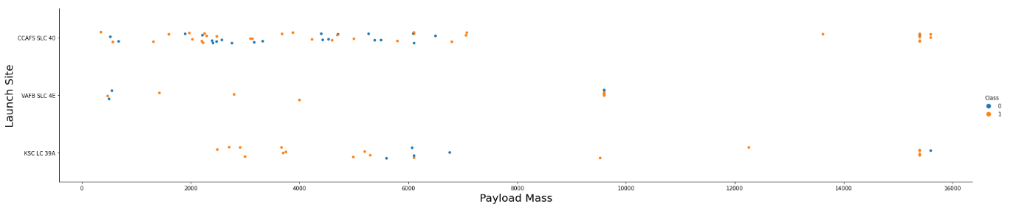
Payload vs. Launch Site
Show a scatter plot of Payload vs. Launch Site
Show the screenshot of the scatter plot with explanations
Based on the scatter plot above, we can see that SpaceX launches typically have a payload mass less than 7000 kg. The outcomes under this threshold have shown mixed results. It appears that flights with a higher payload, while not as common, have shown to be more successful, across all launch sites.

Slide 20
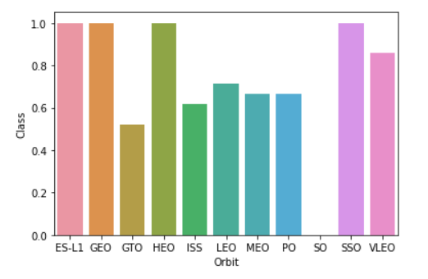
Success Rate vs. Orbit Type
Show a bar chart for the success rate of each orbit type
Show the screenshot of the scatter plot with explanations
Based on the bar graph above, we can see which SpaceX orbit types are more likely to be successful. On average the lower distance orbits tend to be less successful.

Slide 21
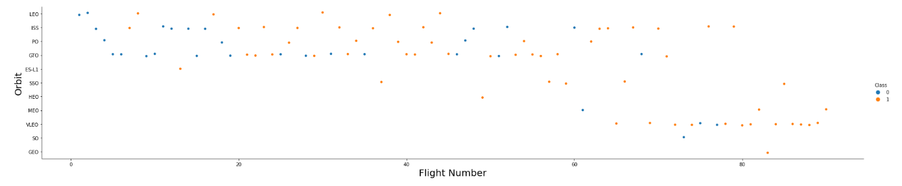
Flight Number vs. Orbit Type
Show a scatter point of Flight number vs. Orbit type
Show the screenshot of the scatter plot with explanations
Based on the scatter plot above, we can see which SpaceX orbit types are more likely to be successful as the program advanced. We can see most of the earlier mission focused on low earth orbits. More recently many of the missions have been very low earth orbits which have been very successful.

Slide 22
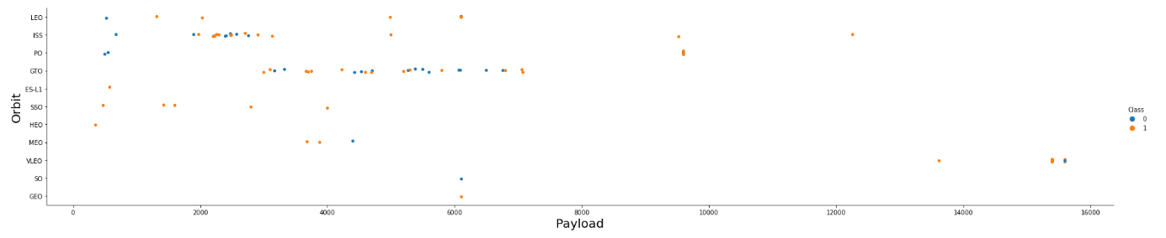
Payload vs. Orbit Type
Show a scatter point of payload vs. orbit type
Show the screenshot of the scatter plot with explanations
Based on the scatter plot above, we can see that payloads under 7000 kg and low earth orbits are more frequently used, with mixed outcomes. The higher payloads, while more rarely used do appear to be more successful.

Slide 23
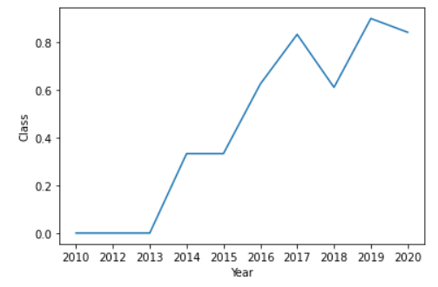
Launch Success Yearly Trend
Show a line chart of yearly average success rate
Show the screenshot of the scatter plot with explanations
Based on the line graph above, we can that the success rate of the program has risen over the years, despite a dip in performance in 2018.

Slide 24
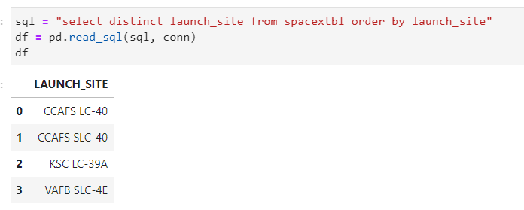
All Launch Site Names
Find the names of the unique launch sites
Present your query result with a short explanation here

Slide 25
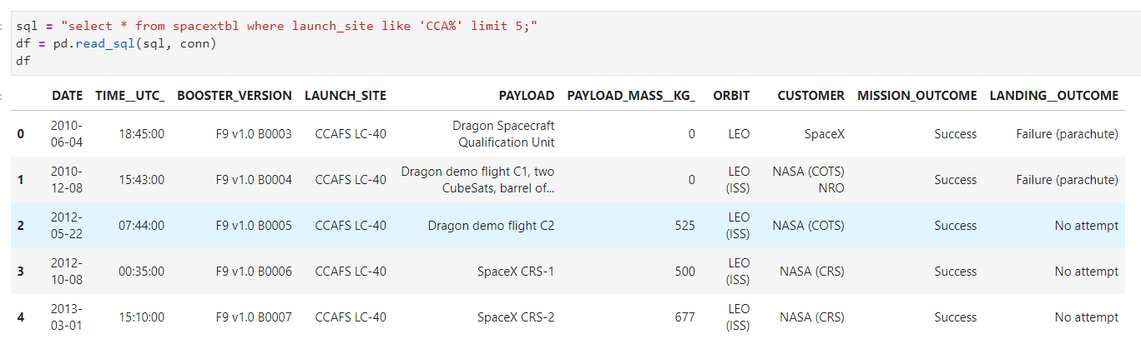
Launch Site Names Begin with 'CCA'
Find 5 records where launch sites begin with `CCA`
Present your query result with a short explanation here

Slide 26
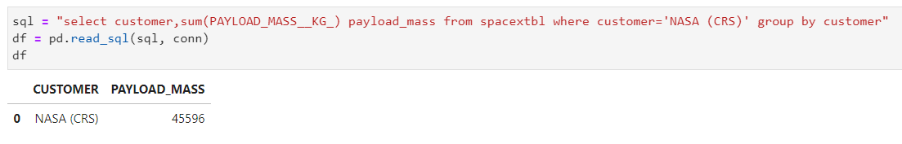
Total Payload Mass
Calculate the total payload carried by boosters from NASA
Present your query result with a short explanation here

Slide 27
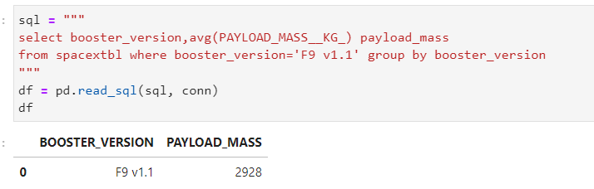
Average Payload Mass by F9 v1.1
Calculate the average payload mass carried by booster version F9 v1.1
Present your query result with a short explanation here

Slide 28
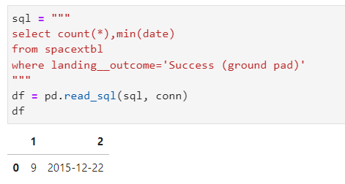
First Successful Ground Landing Date
Find the dates of the first successful landing outcome on ground pad
Present your query result with a short explanation here

Slide 29
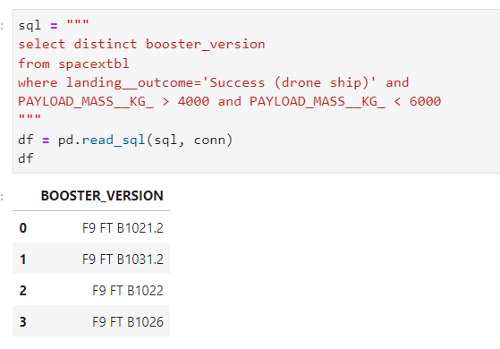
Successful Drone Ship Landing with Payload between 4000 and 6000
List the names of boosters which have successfully landed on drone ship and had payload mass greater than 4000 but less than 6000
Present your query result with a short explanation here

Slide 30
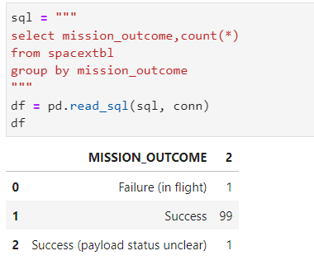
Total Number of Successful and Failure Mission Outcomes
Calculate the total number of successful and failure mission outcomes
Present your query result with a short explanation here

Slide 31
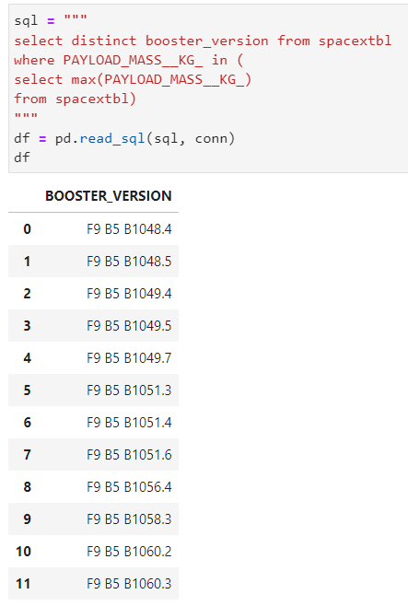
Boosters Carried Maximum Payload
List the names of the booster which have carried the maximum payload mass
Present your query result with a short explanation here

Slide 32
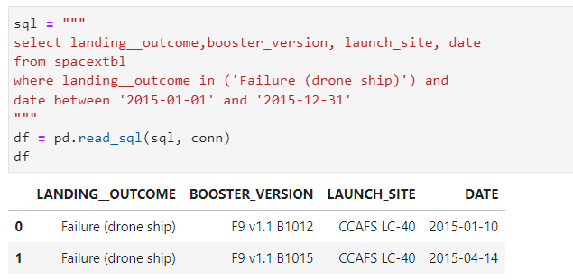
2015 Launch Records
List the failed landing_outcomes in drone ship, their booster versions, and launch site names for in year 2015
Present your query result with a short explanation here

Slide 33
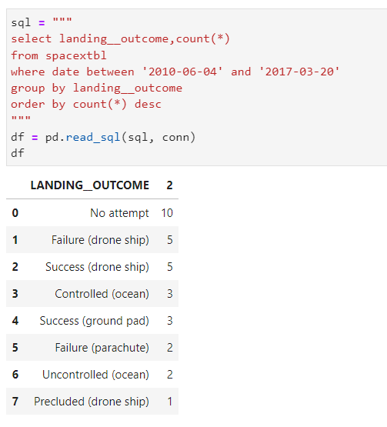
Rank Landing Outcomes Between 2010-06-04 and 2017-03-20
Rank the count of landing outcomes (such as Failure (drone ship) or Success (ground pad)) between the date 2010-06-04 and 2017-03-20, in descending order
Present your query result with a short explanation here

Slide 34

Section 3

Slide 35
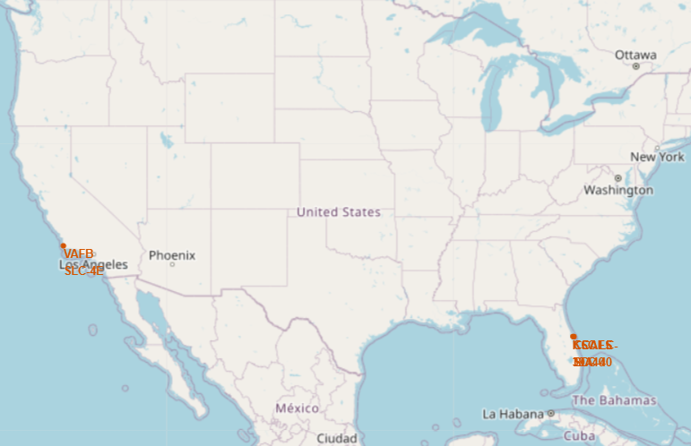
Folium Map of Launch Sites
Replace <Folium map screenshot 1> title with an appropriate title
Explore the generated folium map and make a proper screenshot to include all launch sites’ location markers on a global map
Explain the important elements and findings on the screenshot

Slide 36
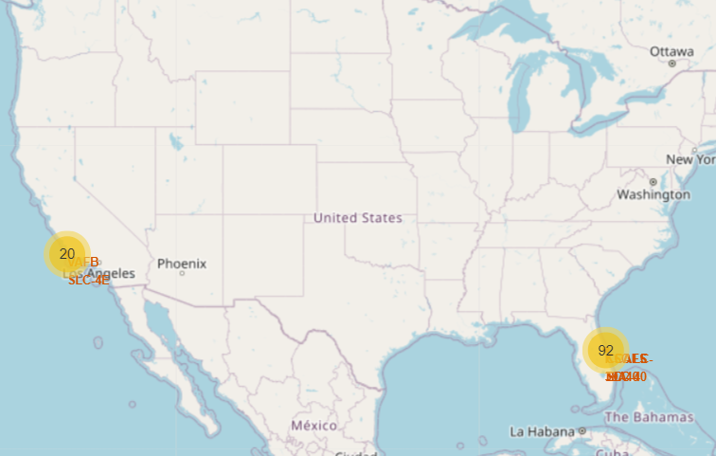
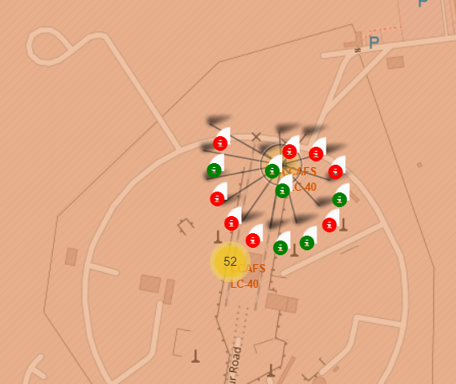
Folium Interactive Map with Site Outcomes
Replace <Folium map screenshot 2> title with an appropriate title
Explore the folium map and make a proper screenshot to show the color-labeled launch outcomes on the map
Explain the important elements and findings on the screenshot

Slide 37
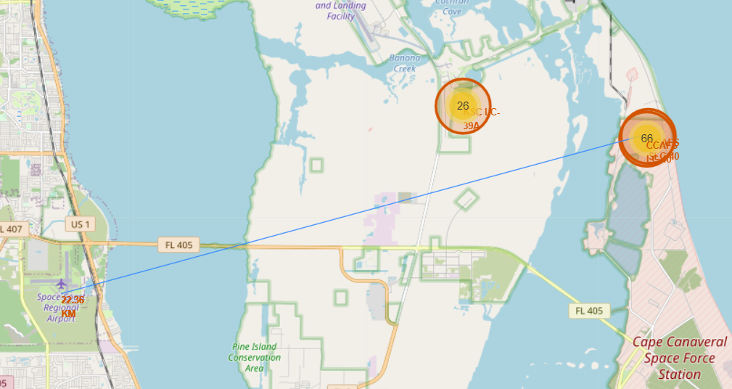
Folium Map of Launch Sites – Distance to Landmarks
Replace <Folium map screenshot 3> title with an appropriate title
Explore the generated folium map and show the screenshot of a selected launch site to its proximities such as railway, highway, coastline, with distance calculated and displayed
Explain the important elements and findings on the screenshot

Slide 38

Section 4

Slide 39
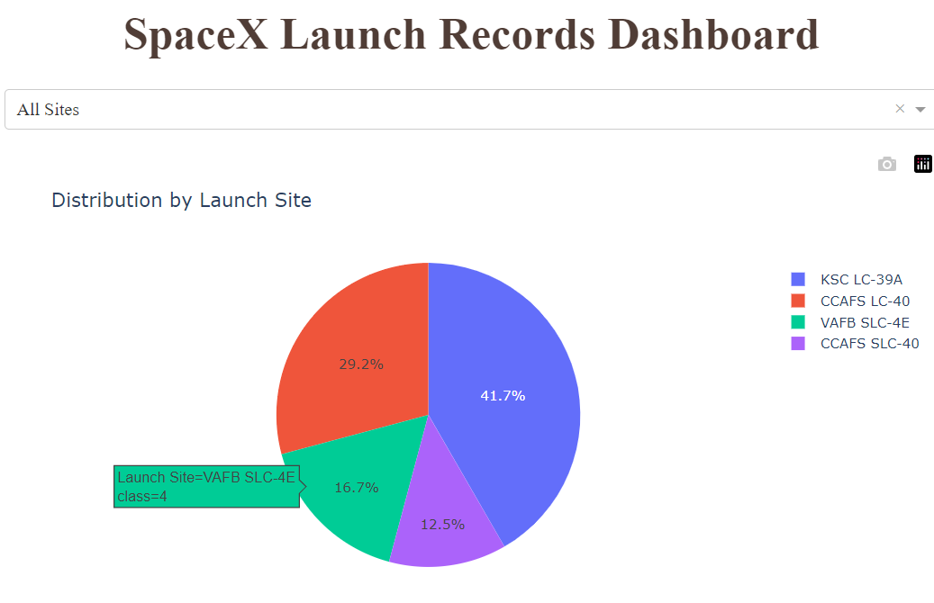
Dash - Distribution of Missions by Launch Site
Replace <Dashboard screenshot 1> title with an appropriate title
Show the screenshot of launch success count for all sites, in a piechart
Explain the important elements and findings on the screenshot

Slide 40
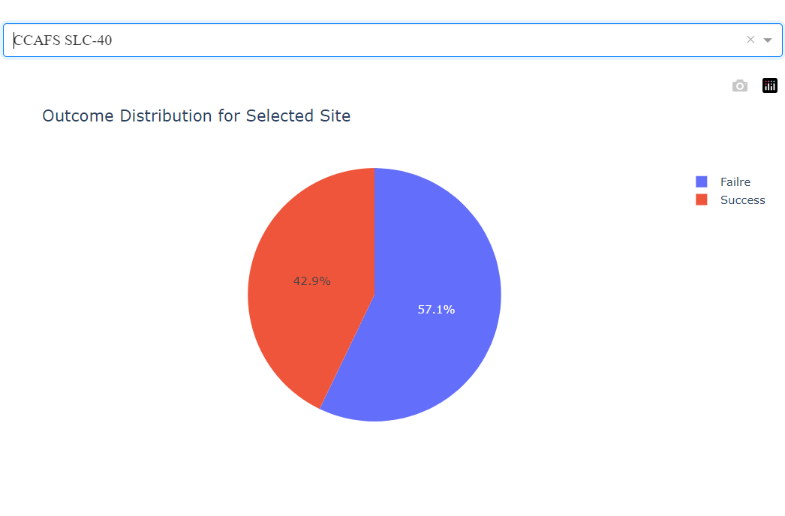
Dash – Success Rate by Launch Site
Replace <Dashboard screenshot 2> title with an appropriate title
Show the screenshot of the piechart for the launch site with highest launch success ratio
Explain the important elements and findings on the screenshot

Slide 41
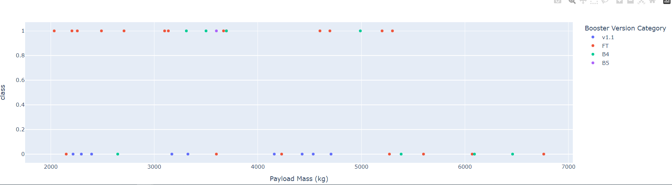
Dash – Outcomes by Payload and Booster
Replace <Dashboard screenshot 3> title with an appropriate title
Show screenshots of Payload vs. Launch Outcome scatter plot for all sites, with different payload selected in the range slider
Explain the important elements and findings on the screenshot, such as which payload range or booster version have the largest success rate, etc.

Slide 42

Section 5

Slide 43
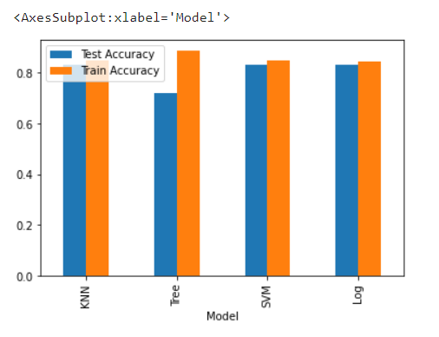
Classification Accuracy
Visualize the built model accuracy for all built classification models, in a bar chart
Find which model has the highest classification accuracy
Outcomes of the 4 Machine Learning models we tested. All did quite well, but the Decision Tree model was most effective.

Slide 44
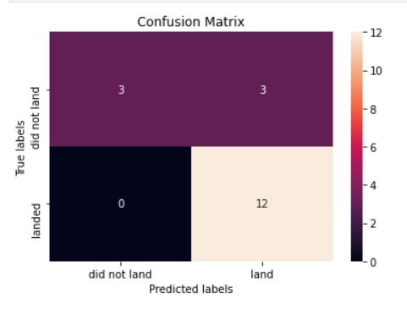
Confusion Matrix
Show the confusion matrix of the best performing model with an explanation
The results of running our test set thru the Decision Tree model which was the most effective of the 4 models we analyzed.

Slide 45
Conclusions
Again while many factors can lead to the success of a mission, we found that results were most favorable with:
Site KSC LC-39A in Florida
Payload Mass <= 7000 kg
Booster Type FT
Low Earth Orbits

Slide 46
Appendix
https://github.com/dheck500/coursera-data-science-capstone
https://api.spacexdata.com/v4/launches/past
https://en.wikipedia.org/wiki/List_of_Falcon_9_and_Falcon_Heavy_launches

Slide 47


